Slide 1

CSC455: Computer Vision
Part 3
Deep Neural Network:
Convolutional Neural Network
Instructor Name: Jamal Hussain Shah
Department of Computer Science, COMSATS University Islamabad, Wah Campus, Pakistan

Slide 2
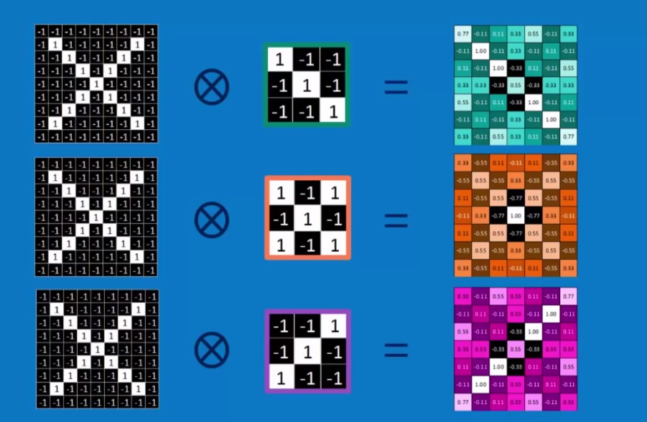
Lecture Review
Introduction to CNN
How to apply filter

Slide 3
Outline
Deep learning Layer
Pooling
ReLu
Fully Connected Layer

Slide 4
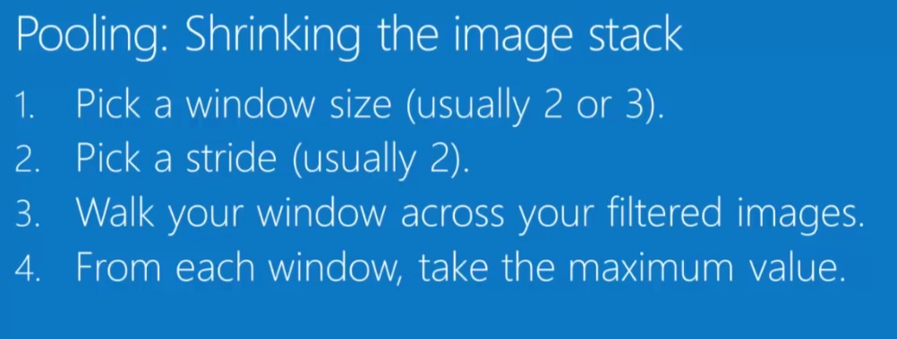

Slide 5
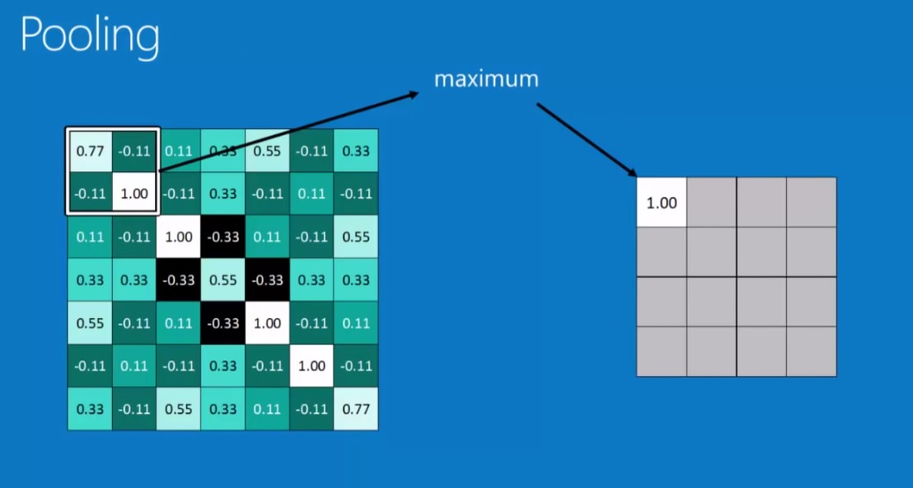

Slide 6
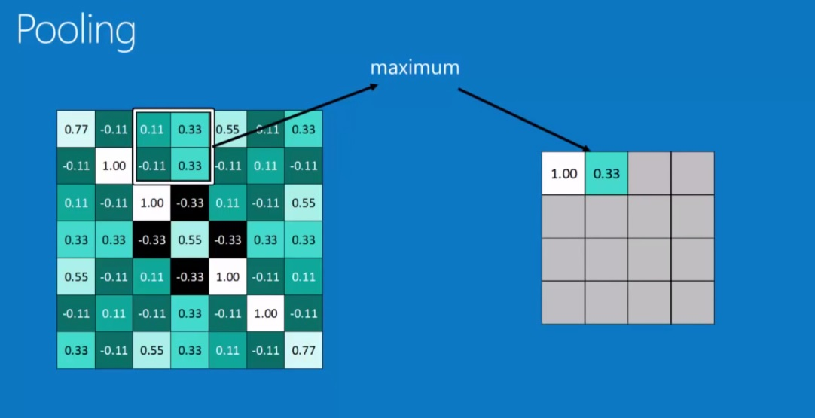

Slide 7
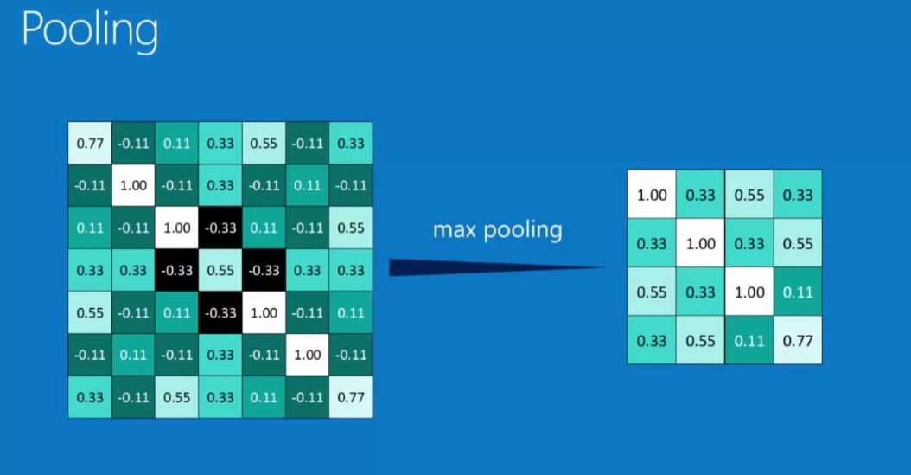

Slide 8
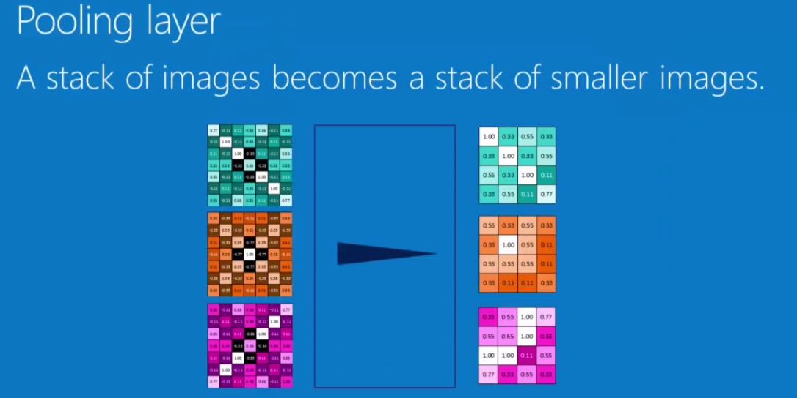

Slide 9
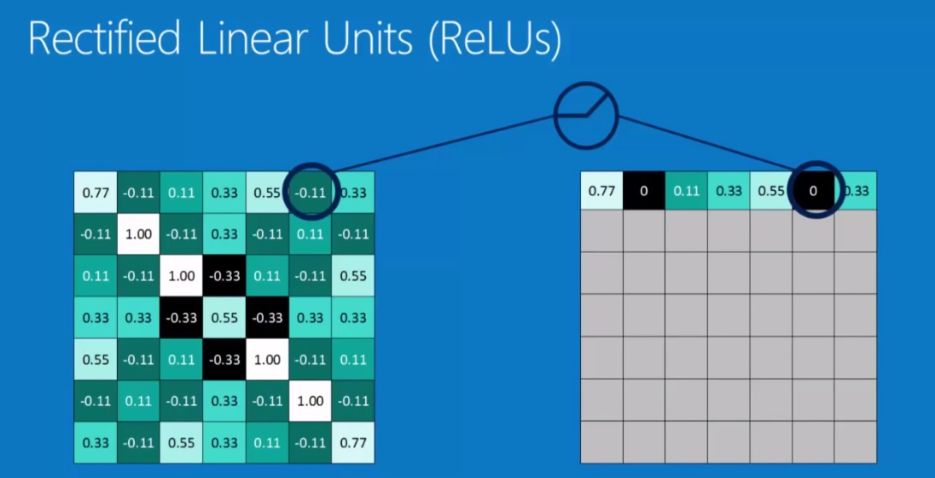

Slide 10
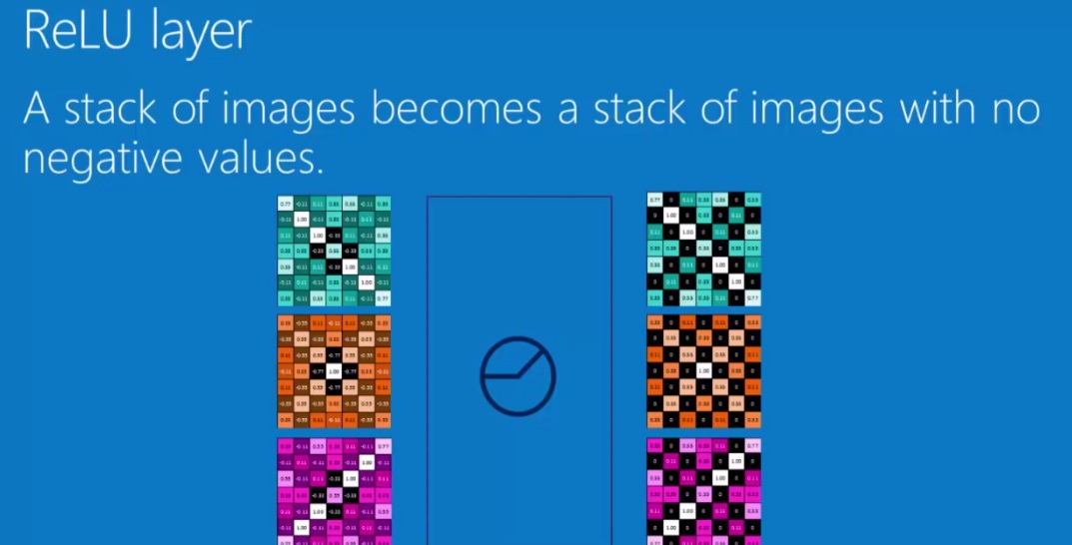
ReLu Layer

Slide 11
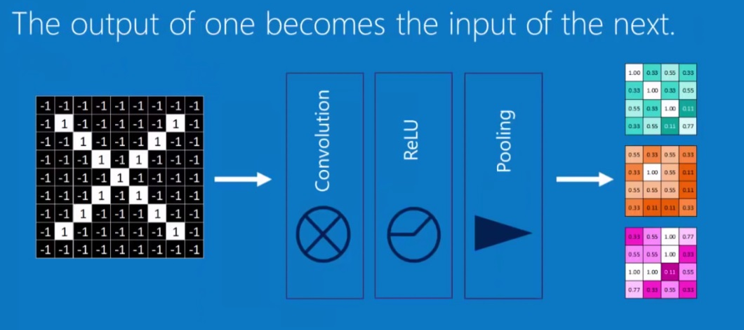
Layer get stacked

Slide 12
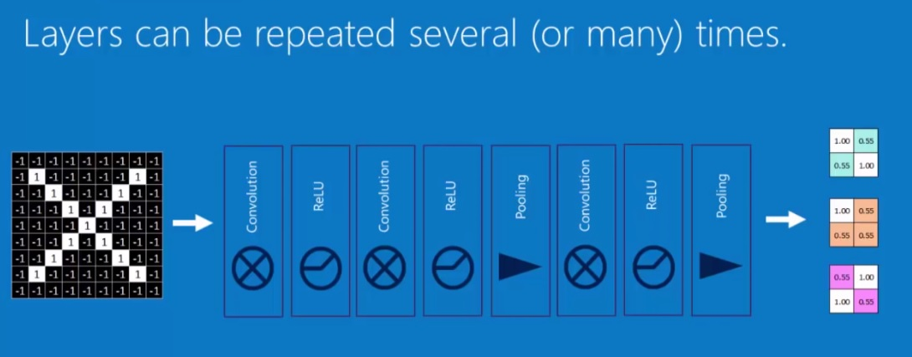
Deep Stacking

Slide 13
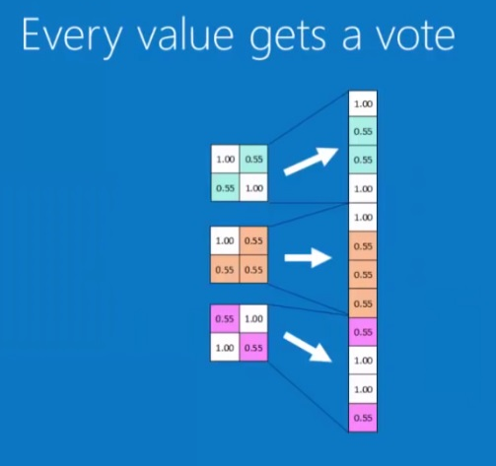
Fully Connected Layer

Slide 14
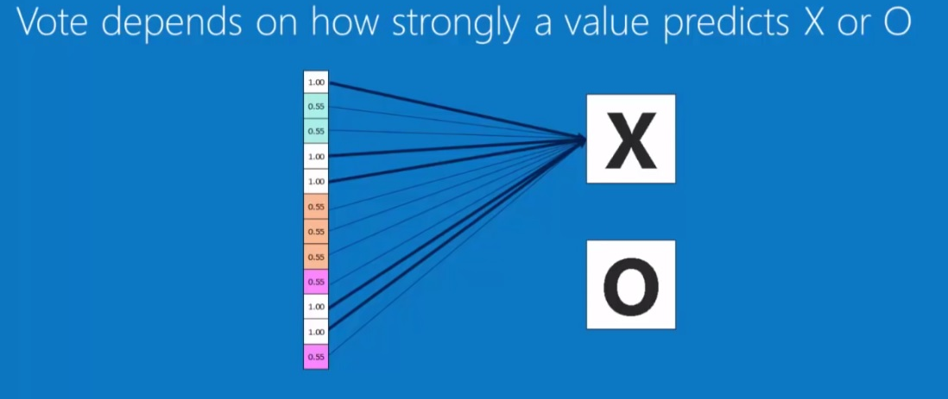
Fully Connected Layer

Slide 15
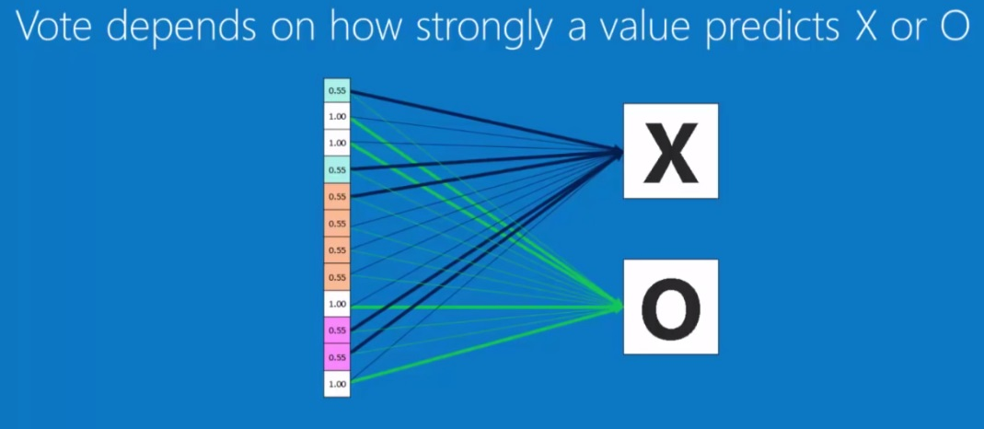
Fully Connected Layer

Slide 16
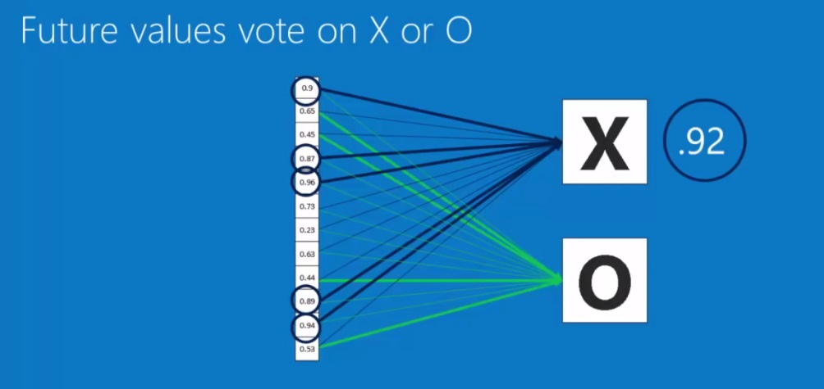
Fully Connected Layer

Slide 17
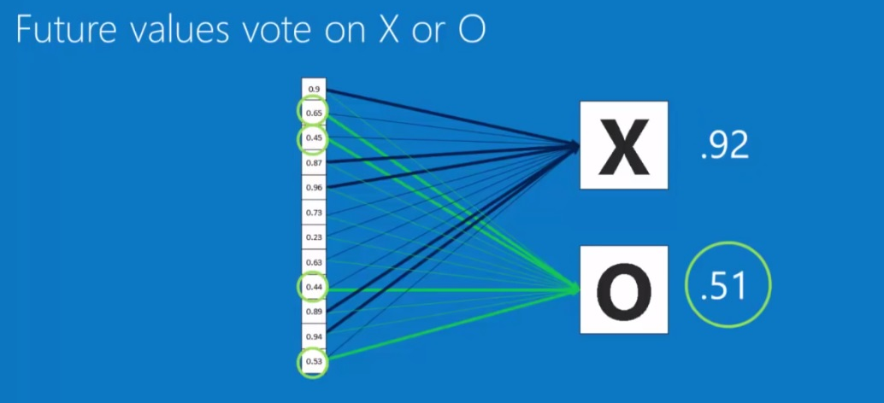
Fully Connected Layer

Slide 18
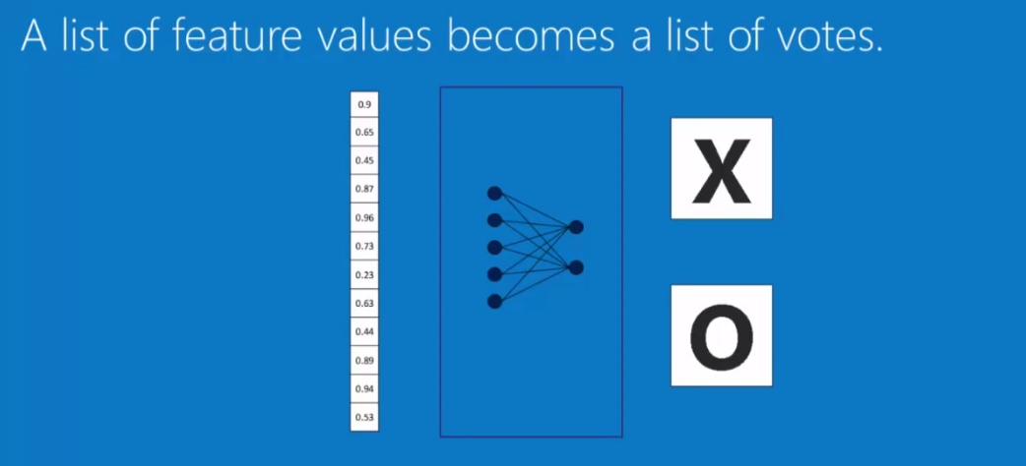
Fully Connected Layer

Slide 19
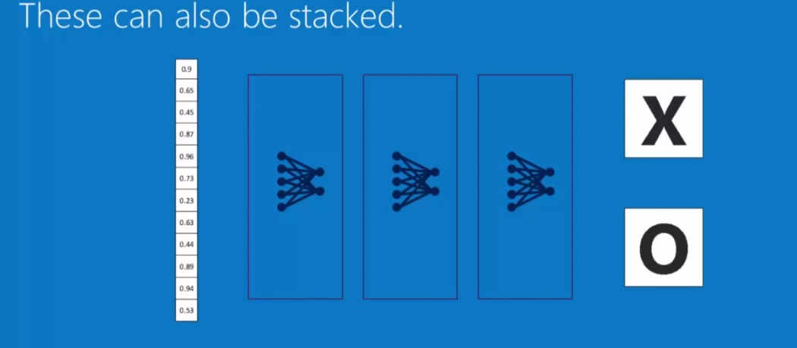

Slide 20
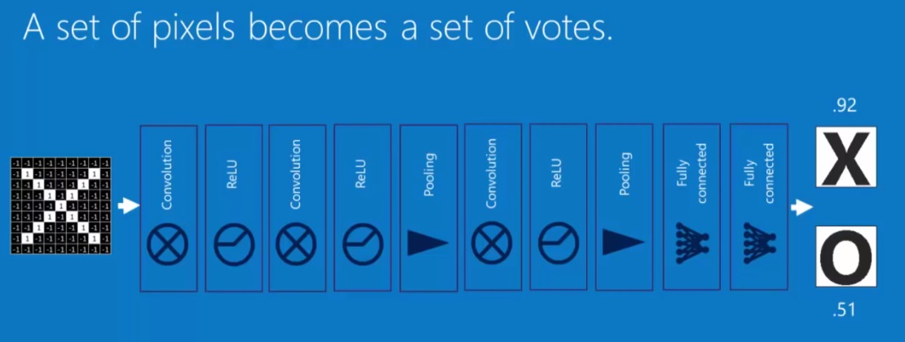
Putting it all togather

Slide 21
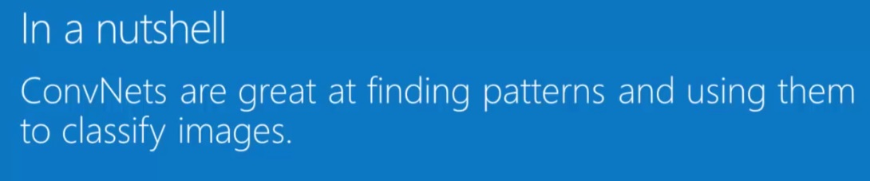

Slide 22

Next Lecture
How to create your own Model

Slide 23
Q&A

